Slide 1


Group 1
Student Behavior Analysis
Project Management Analysis
Archit Navadiya (0815897)
Dhrumil Patel (0813662)
Bhumit Navadiya (0812548)
Arbaz Shaikh (0823127)
Felix Saji (0803791)

Slide 2
Agenda
A walk-through of 5 process groups of our project
1. INITIATING
Student Behavior Analysis
2. PLANNING
3. EXECUTING
4. MONITORING & CONTROLLING
5. CLOSING

Slide 3

INITIATING

Slide 4
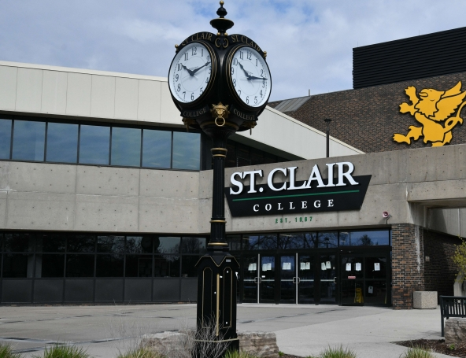


Introduction
INITIATING
We've have completed almost 15 months now. And we all have been through a lot, be it at work or in the college completing assignments and submitting projects and so on.
We all had a different experience while adjusting in our houses and in the college. Some of us had a smooth transition, and some had difficulties. It is believed that demographic factors and past experiences play a significant role in shaping our future academic and living experiences in a new place.
And to gain more insight into this and to know the specific factors that impacts the most, we are analyzing student experience by asking them directly about their feedback.

Slide 5


Objectives
INITIATING
Gain profound insights into the student experience by assessing the existing college amenities.
Produce quantifiable results to inform strategic decisions aimed at enhancing facilities based on current student ratings.
Empower the college to make informed decisions, ultimately elevating program offerings and overall student satisfaction.
Improve support services to create a tailor-made, positive learning environment that aligns with students' evolving needs.
Objective
Goal
Impact
Purpose

Slide 6


Scope
INITIATING
Inclusion Criteria: All current enrollees in programs at Zekelman School of Information and Technology are included, with no exclusions based on program, year, or other demographics.
Survey Content: The survey focuses on program satisfaction, faculty interactions, facility usage, support services, and overall student experience.
Data Collection: Approximately 1600 students will participate in the online survey administered via Microsoft Forms. Communication channels include Blackboard, WhatsApp groups, and in-person visits, with no use of external channels. The project, running from September 19, 2023 to April 15, 2024, encompasses milestones such as survey development, approval, data gathering, processing, and report assembly.

Slide 7


Stakeholders
INITIATING
Ruth Susannah
Chairperson
Melissa McNamara
Administrative Assistant
Prof. Manjari Maheshwari
Project Advisor
A stakeholder is either an individual, group or organization that’s impacted by the outcome of a project or a business venture. Stakeholders have an interest in the success of the project and can be within or outside the organization that’s sponsoring the project.
Prof. Pratik Bedi
Project Advisor
Prog. Coordinators
Prog. Coordinators
Survey Participants
Students under
Zekelman School of IT
Group 1
Group 1

Slide 8
PLANNING

Slide 9



$2.5M
Employees
Approximate budget of $2.5 million designated for various employee roles like managers and analysts.
Budget
$400K
Technology
Dedicate $400K for technology expenses, including survey forms, GCP, automation tools, and Tableau software.
$400K
Communication Tools
Allocate $400K for communication tools, covering the design and printing of promotional flyers and materials.
Our capstone project is allocated a budget of $4 million, with a comprehensive breakdown as follows: Employees (Manager, Analysts, etc.) accounting for $2.5 million, Technology expenses including Forms, GCP, Automate, and Tableau totaling $400,000, Communication Tools (Printing flyers) and Promotion each allocated $400,000, and a Contingency fund of $280,000 for unforeseen circumstances.
$400K
Promotion
Invest $400K in promotion, encompassing marketing strategies and widespread distribution of designed flyers.
$280K
Contingency funds
Set aside $280K for a contingency fund to address unforeseen expenses and emergencies proactively.

Slide 10


Cost

Slide 11



Milestones
PLANNING
Prepare survey questions
Develop the survey
Launch the survey
Prepare and distribute flyers
The total duration of the project is 8 months starting from September 19th, 2023 to April 15th, 2024. However, in the first 4 months of the project, we will collect the data and will perform basic EDA and in the next 4 months, we will be building data pipeline and do the further analysis and visualization.
Monitor responses
Analyze data
Summarize key findings

Slide 12



WBS
Project Analysis of Student Behavior
Project Initiation
Project Planning
Survey Design
Survey Implementation
Data Analysis
Reporting and Documentation
Project Closure
Develop Project Charter
Define Project Objectives
Identify Project Stakeholders
Develop Project Schedule
Identify Constraints and Assumptions
Define Project Scope
Establish Project Criteria for Success
Identify Risks
Develop Survey Questionnaire
Obtain Permission from College
Survey Approval
Finalize Promotional Methods
Design Flyer for Promotion
Publish Survey
Promote Survey Using Blackboard
Promote Survey Using WhatsApp Groups
Promote Survey Through In-Person Visits
Monitor Data Collection and Maintenance
Conduct Exploratory Data Analysis (EDA)
Finalize EDA and Machine Learning Model
Analyze Survey Data Using Tableau and Python
Generate Data Analysis Report
Prepare for Final Presentation
Develop Final Project Report
Deliver Final Presentation
Submit Final Report
Evaluate Stakeholder Satisfaction
Document Lessons Learned
Complete Project Closure Documentation
Work Package

Slide 13


RACI Matrix
Task | Archit Navadiya (Project Manager) | Dhrumil Patel (Developer) | Felix Saji (Documentation Lead) | Bhumit Navadiya (Subject Matter Expert) | Arbaz Shaikh (Research and Developement)
Preliminary Research Document | R | I | A | C | C
Project Business Case | R | I | A | C | I
Project Charter | R | I | A | C | I
WBS Creation | R | I | A | C | I
RACI Matrix | R | I | A | C | I
Minutes Of Meeting | A | I | R | C | I
Flyer Distribution | I | C | C | R | A
Stakeholder Register | R | R | A | I | C
Survey Creation | R | R | A | I | C
Survey Promotion | A | C | I | R | C
Quality Check | A | I | C | R | R
Data Storage | R | C | C | A | R
Data Assessment | R | A | I | C | I
Exploratory Data Analysis | R | A | I | C | I
Data Visualization | R | A | I | C | I
Change Log and Change Request | I | C | R | A | R
Monitor Risk | A | R | R | C | I
Project Presentation | A | R | C | I | R

Slide 14



Survey Design
The survey covers who we are, where we live, and how we balance work and studies. It asks about our backgrounds, living situations, and the juggle between jobs and academics. This helps us understand everyone's unique experiences and make suggestions to make things better for all students.
Demographics
Accommodation &
Convenience
Employment &
Scholastics
01
02
03

Slide 15


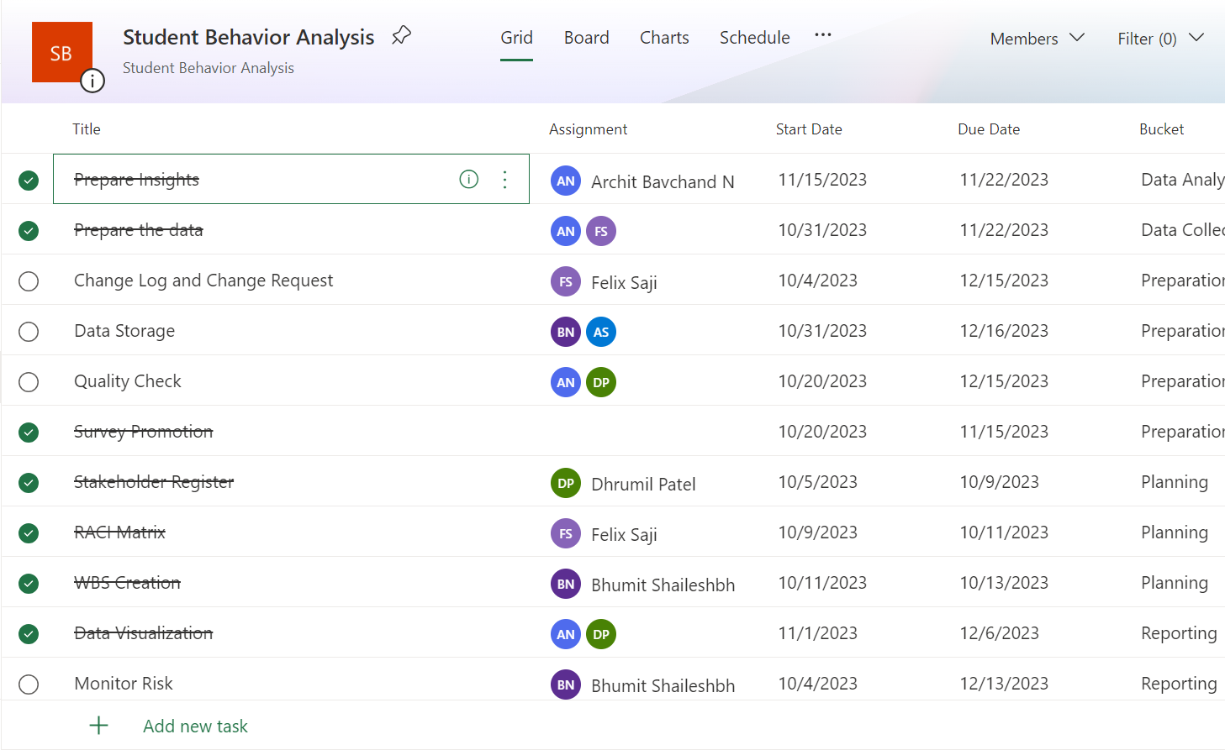

Resource Work Activities Chart

Slide 16



Risk Outlook
Low response rate
Change in Marketing strategy
If there are not sufficient response, then the insights gained would not be accurate and could be biased.
Implement targeted outreach strategies and incentives to encourage greater participation.
Technological error
Monitor all the tools regularly
Potential technical glitches in survey tools or data analysis platforms may disrupt data collection and analysis.
Regularly update and test survey tools and data analysis platforms for optimal functionality.
Mishandling of the Data
Apply Data Security
If there is any data breach or the data is mishandled, then there could be a risk of data confidentiality.
Utilize data anonymization methods and establish strict access controls to safeguard data integrity.
Misalignment with College Goals
Design questions accordingly
All the findings would reduce the overall impact if the results of the survey do not support college’s overall goals.
Align survey questions with college objectives and periodically reassess to ensure relevance.

Slide 17

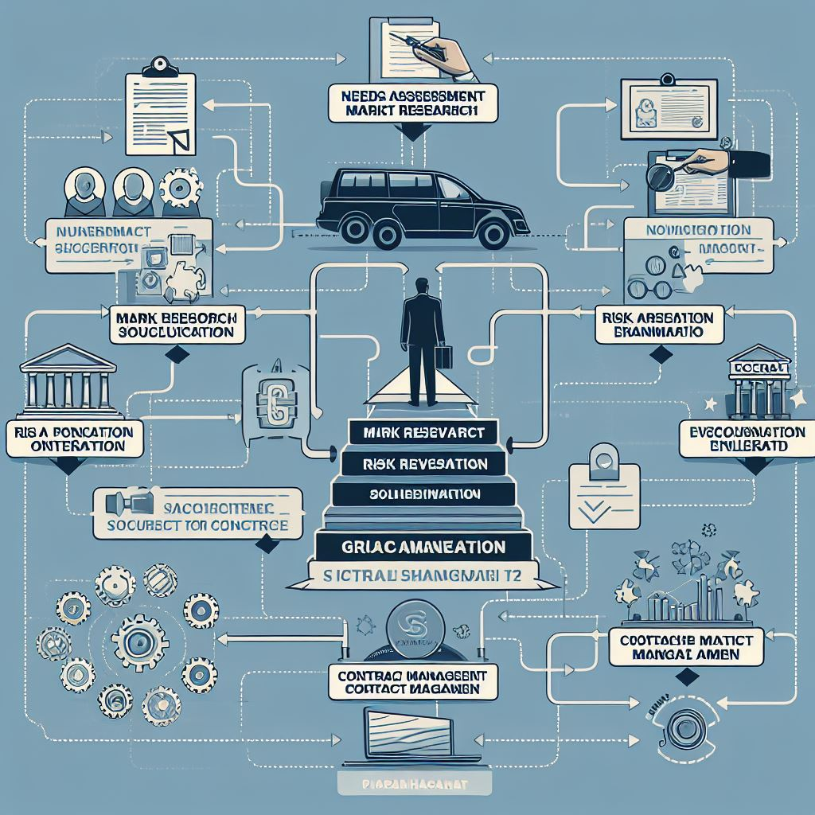
Procurement Plan
Expertise
Permissions
Security Measures
Hardware & Software
Specialized in survey methodologies, data collection, and analysis specifically focused on student behavior and program satisfaction surveys.
Obtaining the necessary legal rights or permissions to utilize certain tools, software, or data for conducting the survey and its subsequent analysis.
Consider employing encryption techniques, secure servers, and access controls to prevent unauthorized access to ensure safety of survey application
Secure scalable infrastructure for managing survey data effectively, essential software for creating and analyzing student feedback.

Slide 18
EXECUTING

Slide 19


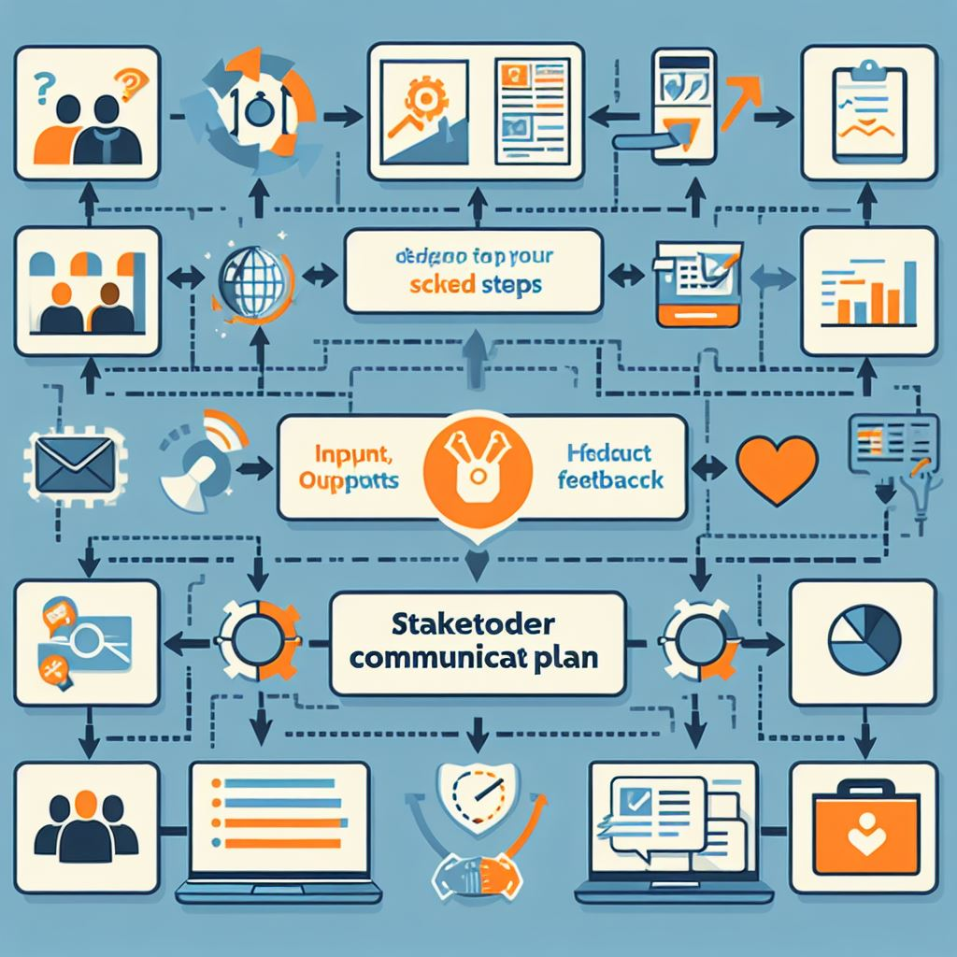
Stakeholder Register
STAKEHOLDER REGISTER
OVERVIEW |  |  |  |  |  |  |  | CONTACT
ID | STAKEHOLDER | TITLE / ROLE | INTEREST / EXPECTATIONS | STAKE IN PROJECT | POTENTIAL IMPACT | Frequency of Contact | CATEGORY | Email
1 | Ruth Susannah | Chairperson | Approver and decision-maker for project initiation. | High | High, as approval is necessary | As Needed | External | rsusannah@stclaircollege.ca
2 | Manjari Maheshwari | Project Advisor | Provide guidance and support throughout the project. | High | High, as expertise is crucial | Weekly | Internal | mmaheshwari@stclaircollege.ca
2 | Pratik Bedi | Project Advisor | Provide guidance and support throughout the project. | High | High, as expertise is crucial | Weekly | Internal | pbedi@stclaircollege.ca
3 | Melissa McNamara | Administrative Assistant | Offers administrative support and logistics assistance. | Medium | Moderate, as logistics support is crucial | Weekly | External | mmcnamara@stclaircollege.ca
4 | Program Coordinators | Program Coordinators | Provide permission for survey distribution. | Medium | Moderate, as they control program activities | As Needed | External
5 | Survey Participants | Students of Zekelman School of IT | Provide data thorugh surveys for Analysis. | Low | High, as they are data sources | As Needed | External
6 | Group 1 | Project Team | Responsible for making a successful project | High | Moderate, as they are data sources | Daily | External | w0815897@myscc.ca W0813662@myscc.ca W0812548@myscc.ca W0823127@myscc.ca W0803791@myscc.ca

Slide 20
Project Communication Plan
Stakeholders | Deliverables | Frequency | Priority | Delivery method
Zekelman School of Information Technology | The deliverables include a report with key findings, a summary, a presentation, recommendations, and documentations. | As Needed | High | In-person Meeting, Email
Prof. Pratik Bedi | Update regarding the project including survey results and documentations | Weekly | High | In-person
Prof. Manjari Maheshwari | Regular updates on project progress, survey results, and any challenges faced by the group. | Weekly | High | In-person, Email
Students | Provide accurate and honest responses to the survey questions. | Once | High | Email, Blackboard, WhatsApp
Group 1 | Coordination within the group, sharing insights, and addressing any problems faced during the project. | Daily | High | In-person, Phone, Email

Slide 21






Data Collection
We gathered info using Blackboard, where coordinators posted and shared the survey flyer. On WhatsApp, the flyer reached everyone, making it easy to join. In class, we spread the word directly. This mix of online and in-person approaches ensures we hear from everyone, making our survey as inclusive and helpful as possible.
Blackboard
In-class
WhatsApp
01
02
03

Slide 22




Data Analysis
Data is collected through Microsoft Forms, stored in an MS Excel file, and analyzed using Python. The insights obtained from the analysis are visually presented using Tableau, facilitating a clear and comprehensive understanding of the gathered information. This systematic approach ensures a robust foundation for informed decision-making and actionable outcomes.
01
03
02
02

Slide 23

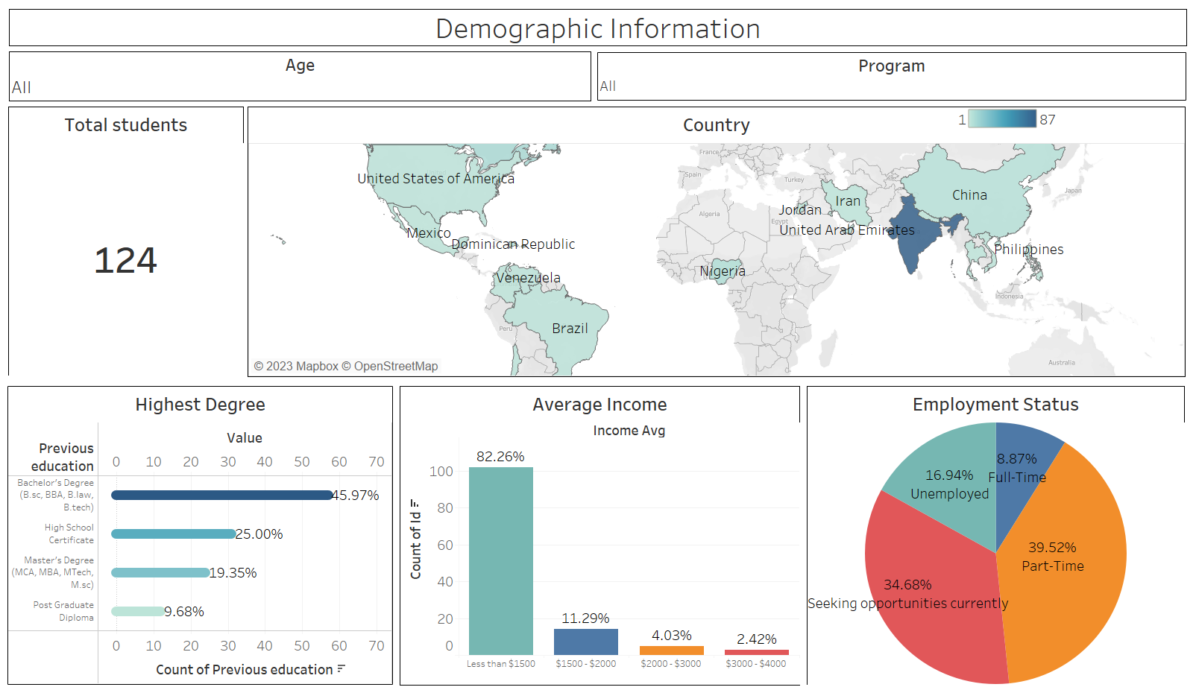
Dashboard

Slide 24
MONITORING & CONTROLLING

Slide 25


Change Log
Flyer promotion
Changed Flyer promotion method
Flyers for the promotion was first supposed to be posted on the walls of both Downtown campus and the South campus and was also decided to display it on the TVs in the campus.
As we approached the SRC for promoting the flyer on the walls and the TVs, we got to know that we would need approval from Ethics Dept. which would further take 1 month and so we just promoted the survey using Blackboard and other methods.
Question modification
Removed the question
Our first question in the survey was whether the student belongs to the program under Zekelman School of Information Technology. And if the student select Yes, only then other questions would be displayed.
The purpose of the question was really to not get false data from the students under other programs that didn’t belong to the Zekelman School of IT with old method of promotion. However, as the new promotion method was to send the flyers only to the desired programs, this question was of no use.

Slide 26
Change Log
Change ID | Category | Description of Change | Submitted by | Submission Date | Status | Disposition
CHG0001 | Scope | Change was made to focus on only students from Zekelman School of IT | Project Manager | 09/27/2023 | Approved | Implemented
CHG0002 | Promotion | Flyer promotion by sticking posters on the wall showing it on TV was terminated | Research & Development | 10/29/2023 | Approved | Implemented
CHG0003 | Requirements | Modifying the survey questions | Developer | 10/29/2023 | Approved | Implemented
CHG0004 | Schedule | Extension of the EDA due to insufficient responses. | Subject Matter Expert | 11/22/2023 | Approved | Implemented

Slide 27


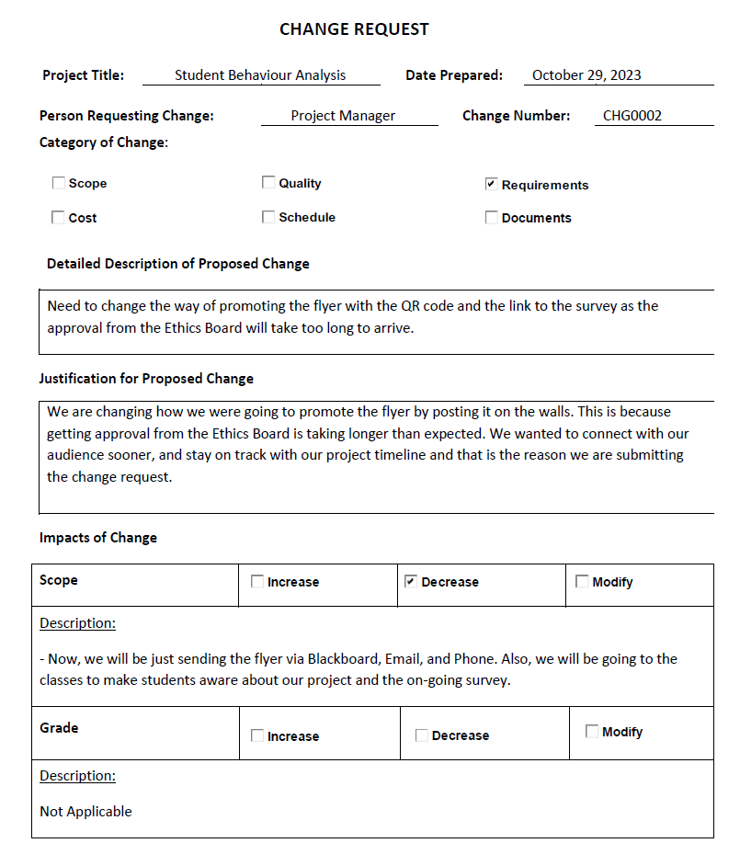
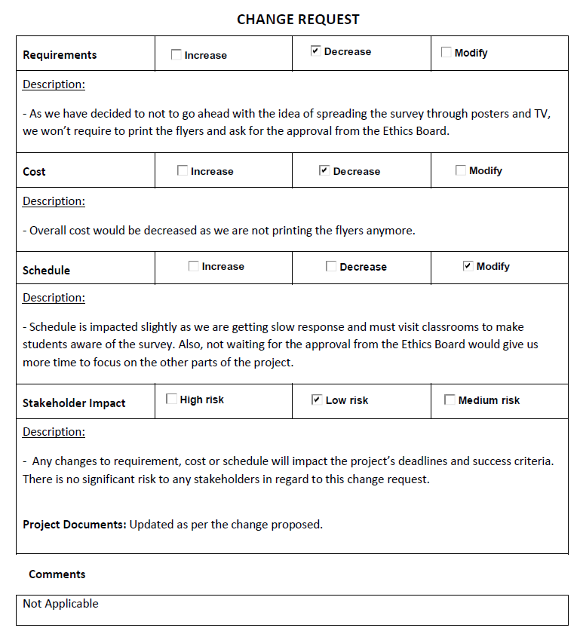
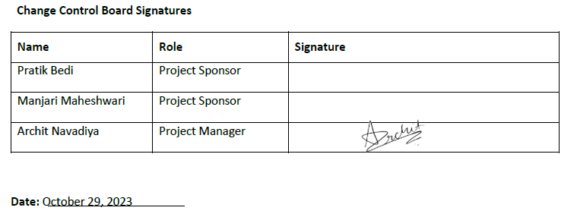
Change Request Form

Slide 28
CLOSING

Slide 29





Demographic Impact
Project Outcomes
We analyzed student demographics to help college tailor support services for targeted initiatives.
Service Awareness and Usage
Evaluated college service awareness and will identify influencing factors and will suggest improvements.
Academic Satisfaction
Examined student satisfaction with workload, section swapping, and scheduling, implementing changes for improvement.
Student Sentiment
Summarized overall student sentiment and will provide recommendations based on the feedback.

Slide 30

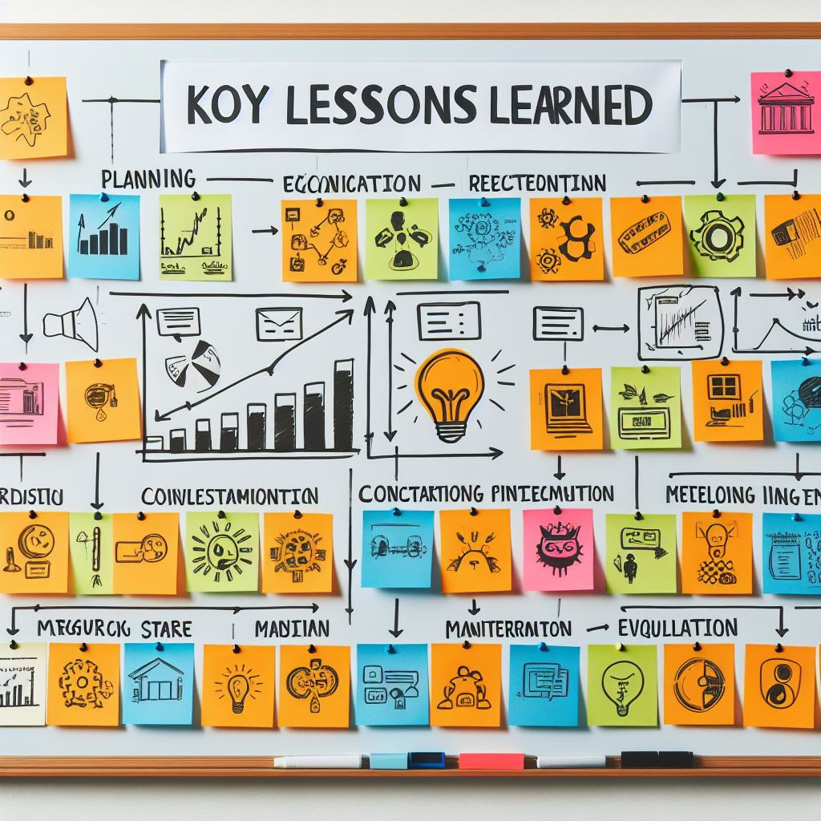

Lessons Learned
ID | Date Identified | Subject | Situation | Recommendations & Comments
1 | 09-26-23 | Survey Update | Initial survey design required adjustments suggested by the professor. | The survey needs more information about why we are taking this survey, who is going to use these details, and about the privacy of data.
2 | 10-03-23 | Survey Promotion | Initial promotion on Blackboard yielded minimal responses, prompting the need for a more engaging promotional strategy. | Develop visually appealing and informative flyers for wider visibility to increase survey participation.
3 | 10-17-23 | Promoting on notice board | The plan to post on notice boards required ethical approval, potentially causing delays in the project timeline. | Factor in the need for ethical approvals early in the planning stage to prevent unforeseen delays.
4 | 11-09-23 | Reposting survey | To get more survey responses we planned to repost on Blackboard | After dropping to post it on the notice board we decided to repost it on Blackboard for more responses and we almost doubled our responses.
5 | 11-23-23 | Data cleaning | Data cleaning and analysis are crucial for meaningful insights and effective dashboard creation. | While cleaning our data we faced several problems as people misspelled province names, in the sector section they have written subfield, not the sector. We learned to give them examples or options for that instead of giving them textbox.

Slide 31
THANK YOU

